Slide 1



The Digital Entrepreneurship Ecosystem Index 2017-2022
special case, Africa
Prof. Dr. Zoltan Acs
Vienna Institute for Global Studies, Modul University, Vienna

Slide 2
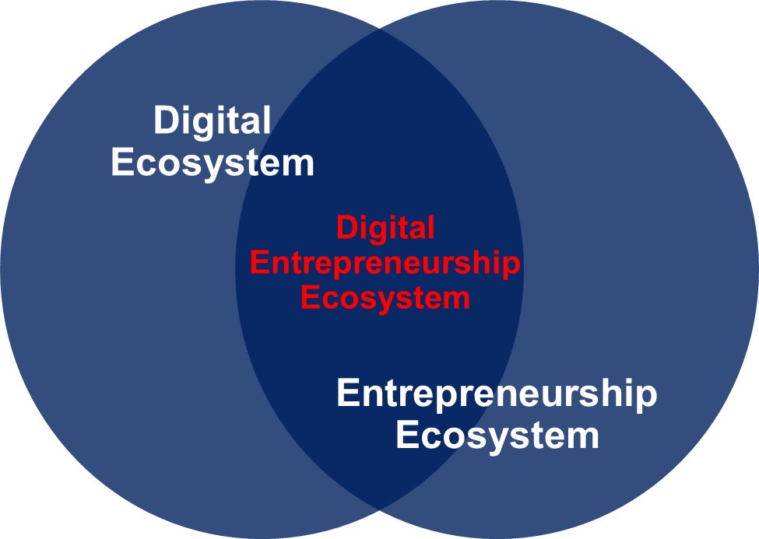
The Digital Entrepreneurship Ecosystem Index
Sussan and Acs (2017) define the digital entrepreneurship ecosystem as the integration of “…the entrepreneurial ecosystem with its focus on agency and the role of institutions and the digital ecosystem with its focus on digital infrastructure and users.” (p. 62)

Slide 3
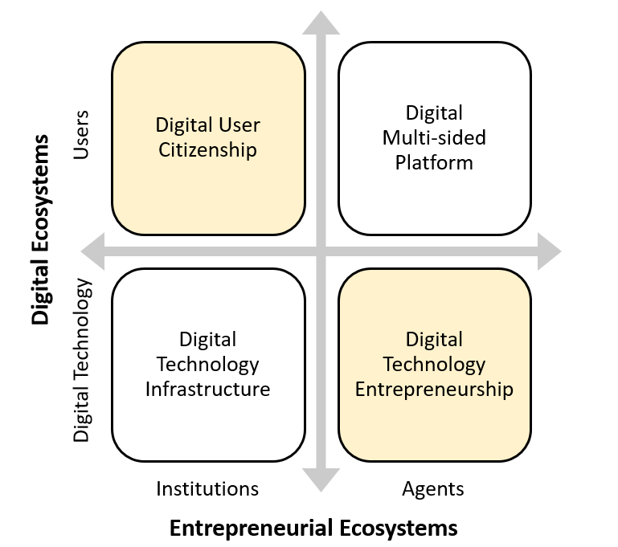
Digital Entrepreneurship Ecosystem – the 4 subindices
The DTI sub-index measures the strength and success of digital technology infrastructure and the institutions that support its development, as a function of digital technology.
The DUC sub-index seeks to quantify the institutional impact on users of digital technology, both in terms of formal legitimacy and social norms.
DMSP is the site of interaction between users of the digital ecosystem and actors (agents) in the platforms.
The DTE sub-index is composed of agents who take part in the increased digitalization of the incumbent businesses and those who involve supporting the digital startup and the scaleup processes.

Slide 4
The conceptual model of the DEE

Slide 5
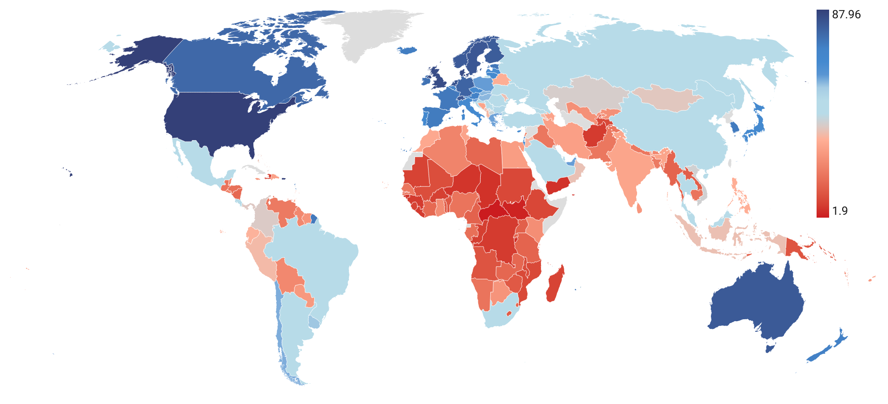
DEE Index global positioning - (2022 data)

Slide 6
DEE Index Ranking 2022

Slide 7
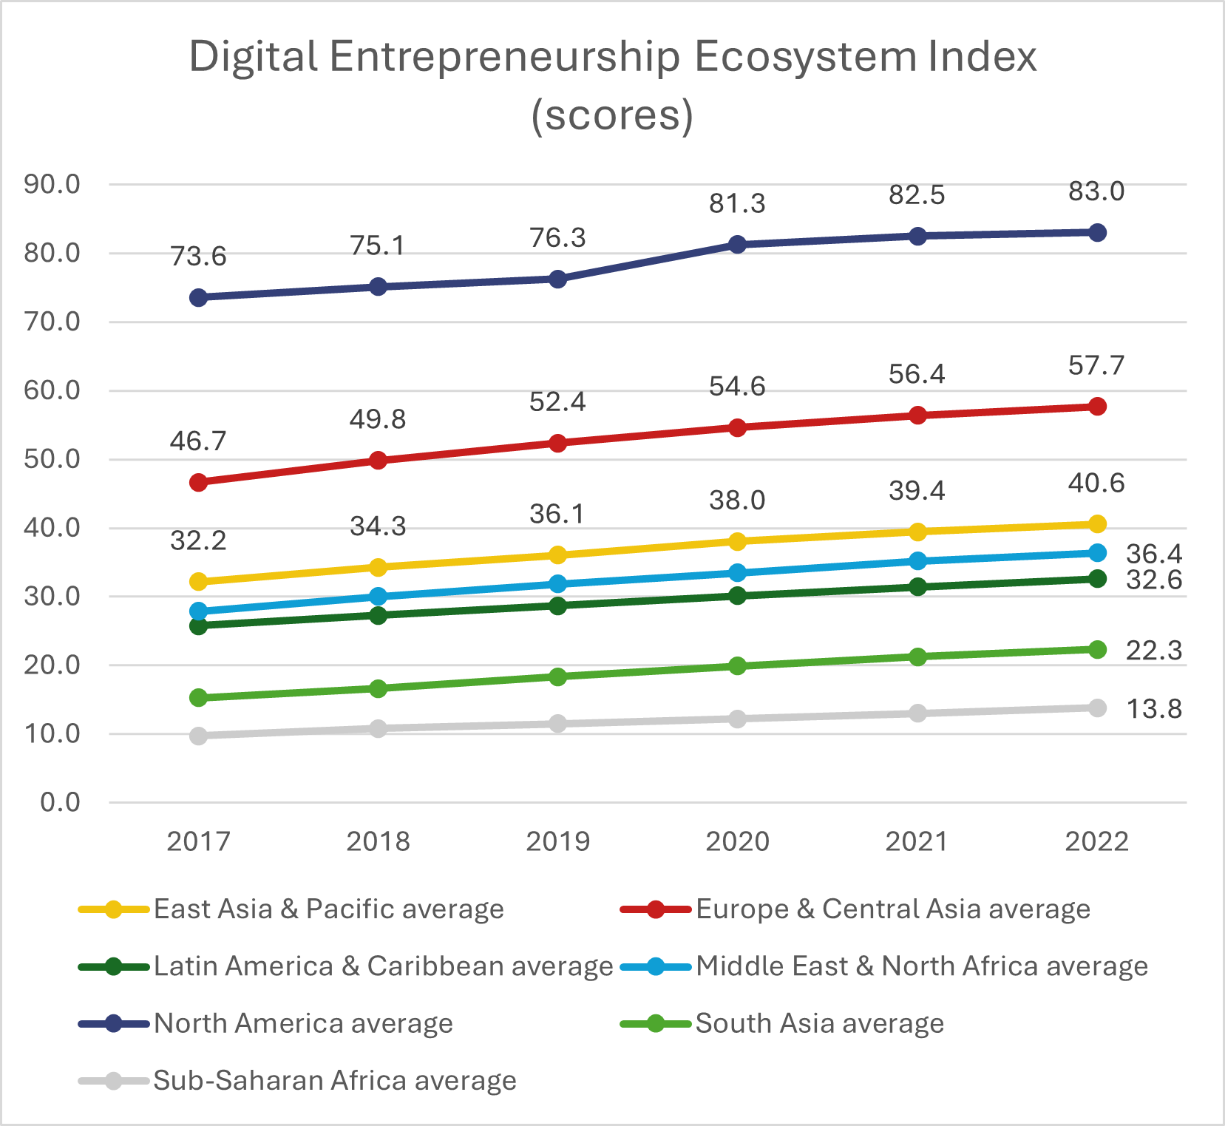
DEE Global Positioning (by geographic region)

Slide 8
DEE results for 2017 and 2022 (by geographic region)

Slide 9
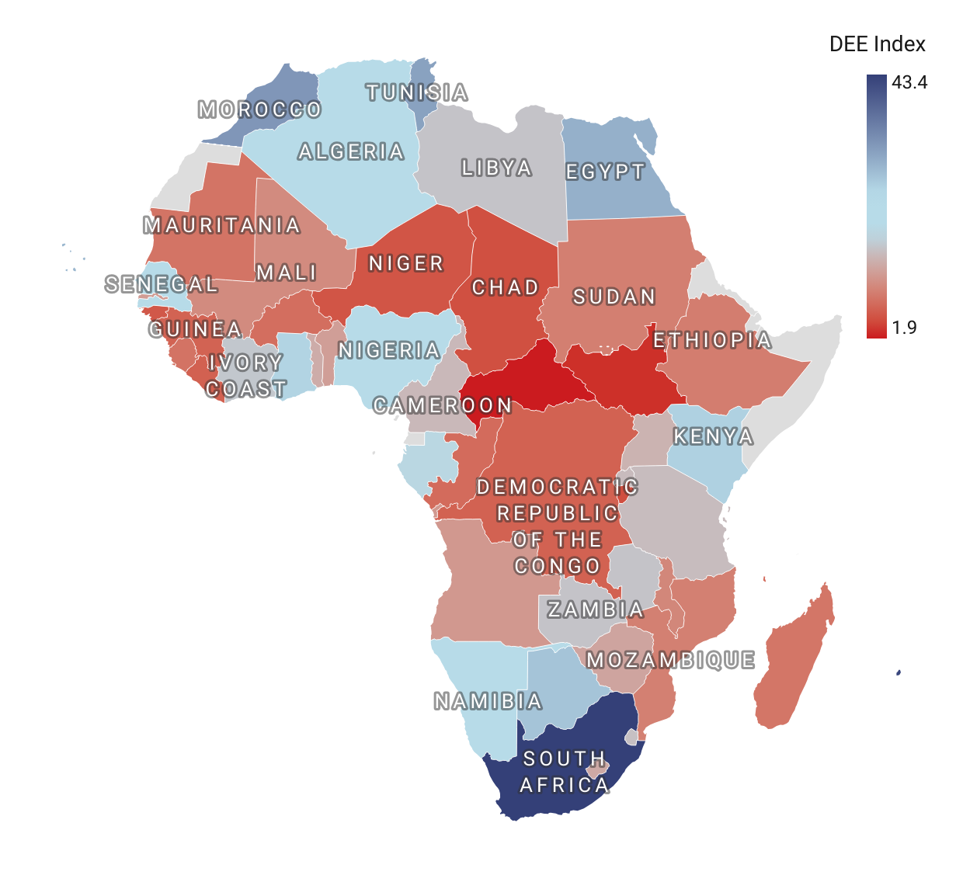
DEE Index scores of Africa’s Countries (2022)
(South Africa as comparison)

Slide 10
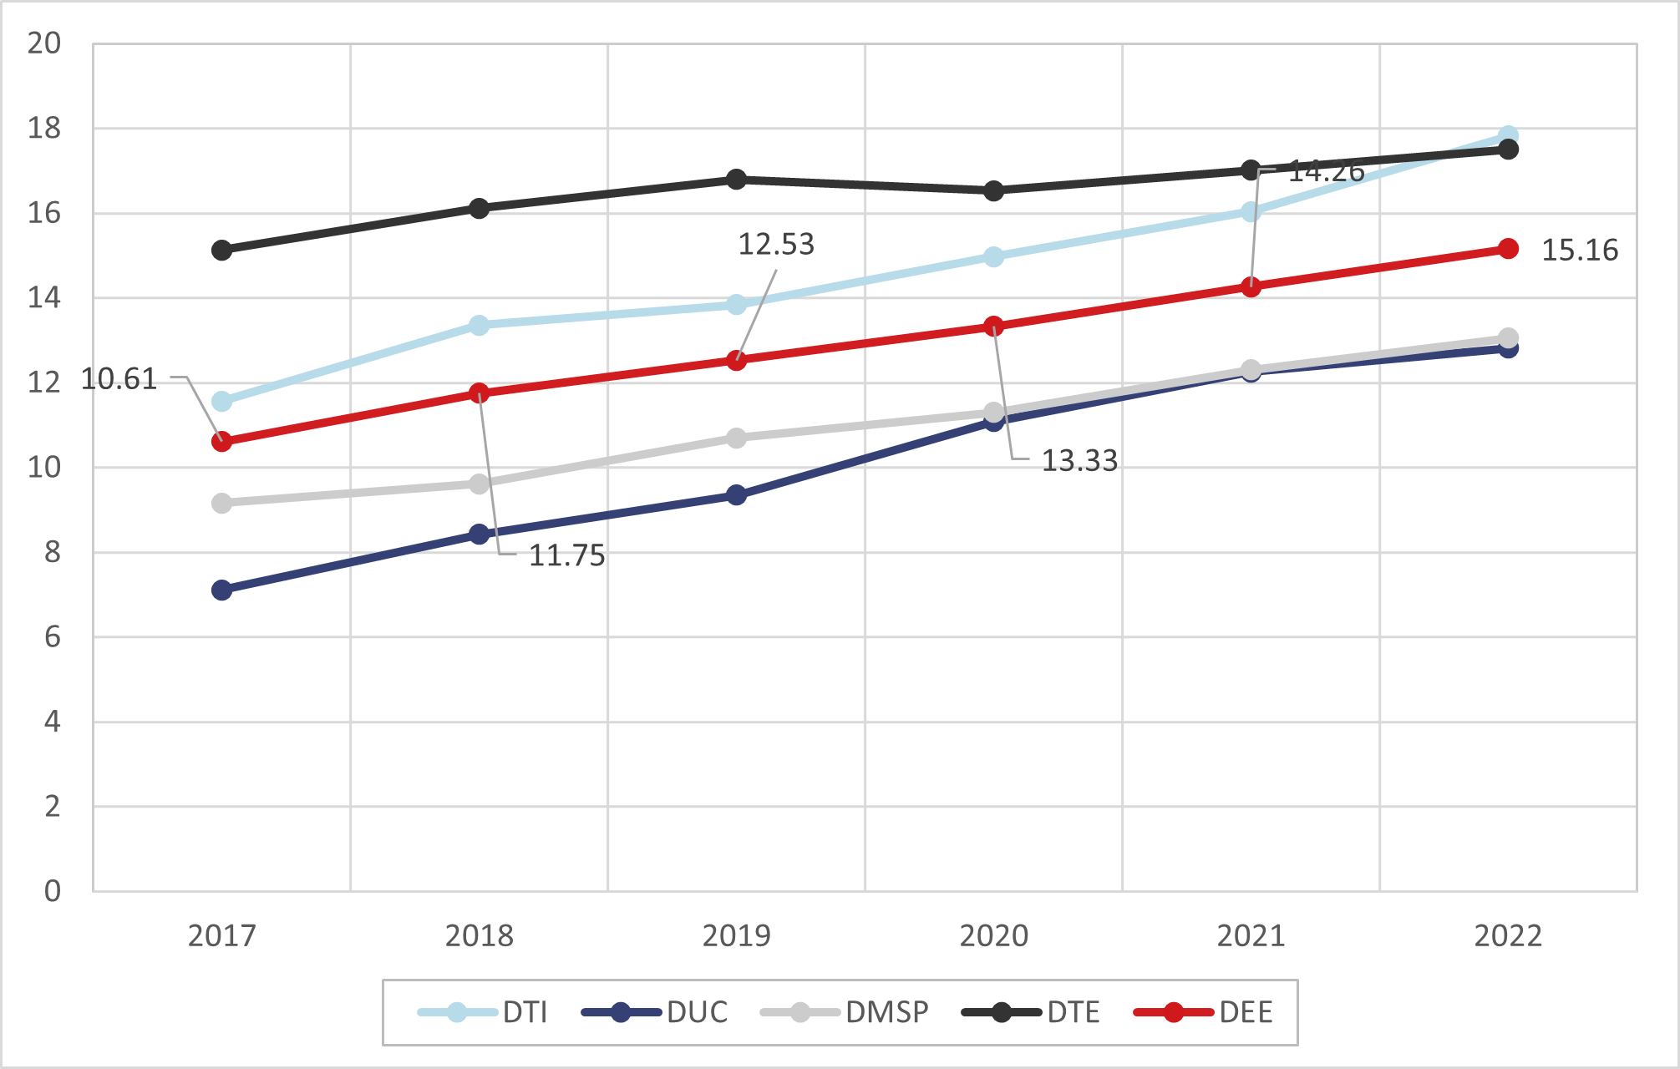
Africa’s DPE and the 4 subindexes development 2017-2022
DTI is the highest – digital technology infrastructure and the institutions that support its development are developed
DUC is the lowest - users of digital technology in both in terms of formal legitimacy and social norms are restricted

Slide 11
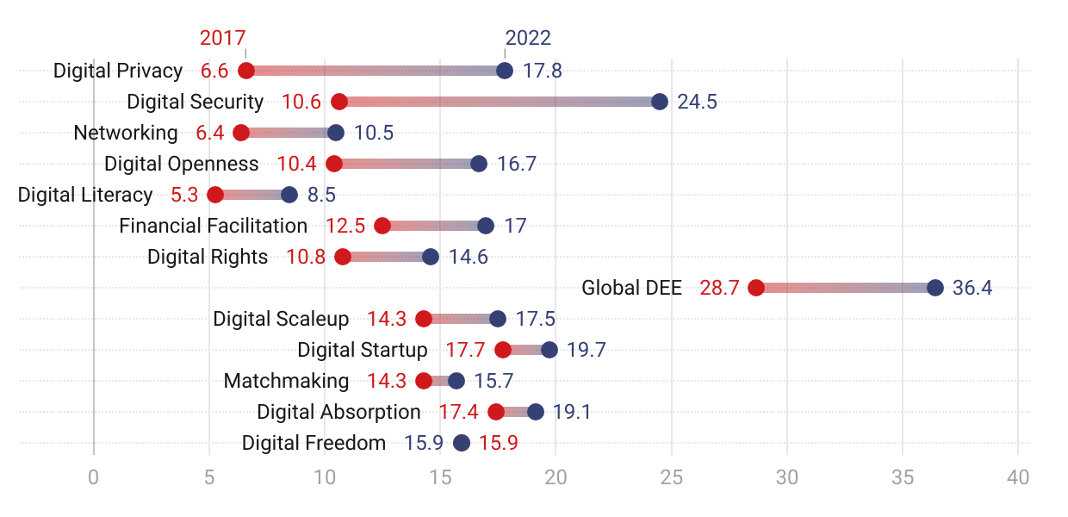
Africa’s twelve pillar changes over 2017-2022

Slide 12
Africa’s DEE-based Policy Suggestion – 10% Increase of the DEE Index Score
Strengths:
Digital Security shows the highest score (24.5 in 2022) – a strong foundation to build trust in digital services.
Digital Privacy (17.8) and Digital Absorption (19.1) are performing relatively well, signaling good adoption of digital tools.
Weaknesses / Priority Areas for Improvement:
Digital Literacy (8.5) is the weakest pillar – this is a major barrier to participation in the digital economy.
Networking (10.5) and Digital Openness (16.7) are still low, limiting ecosystem connectivity and collaboration.
Financial Facilitation (17.0) remains underdeveloped, constraining entrepreneurs' access to funding and financial services.
Moderate Areas (need attention but not critical):
Matchmaking (15.7), Digital Scaleup (17.5), and Digital Startup (19.7) are improving but could be strengthened to accelerate ecosystem growth.

Slide 13
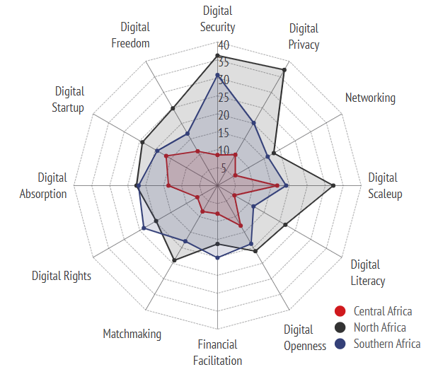
Africa’s regions pillar comparison between country groups
1. North Africa:
Algeria, Egypt, Libya, Morocco, Sudan, Tunisia
2. Central Africa:
Angola, Cameroon, Central African Republic, Chad, Congo, Democratic Republic of Congo, Equatorial Guinea, Gabon
3. Southern Africa:
Botswana, Eswatini, Lesotho, Namibia, South Africa, Zimbabwe, Zambia, Malawi, Mozambique

Slide 14
Summary, conclusion
We are in a mid of a digital technology-led technology/industrial revolution.
Digital technologies are all-purpose techs – affect virtually everything - albeit is a varying way.
Digital Entrepreneurship Ecosystem Index: a composite indicator to measure the extent and the effect of digitalisation on entrepreneurship at country level
Unique to combine most aspects of the digital entrepreneurship ecosystem – cultural aspects are missing
Makes possible to examine DEE and components’ development over time
Identifies and measures the most important agents in DEE
Provides policy suggestions based on bottlenecks in the DEE
DEE is fastly evolving - between 2020-2022 7,3% increase of the DEE scores.

Slide 15
Thanks for your attention!

